Slide 1
Progressing from “Compliant IEPs” to Writing Standards-aligned Individualized Education Programs (IEPs)
Pikes Peak BOCES
September 10, 2015
Exceptional Student Services Unit
Linda Lamirande Rebecca Odegard-Siegele Njal Schold
Notes:
Matt Hudson – Charter School Institute requested training

Slide 2
CDE Strategic Goals: Every Student Every Step of the Way
Start strong
Read by third grade
Meet or exceed standards
Graduate ready
Notes:
These are CDE’s Strategic Goals….while all are incorporated in today’s session, the focus will be on #3, Meet or exceed standards, as we talk about improving student outcomes by writing standards-aligned IEPs for students with a disability who receive special education services.

Slide 3
Statewide Assessment Data
Source: SchoolView Data Center
CSAP/TCAP compared to Students with a Disability (IEP) group:
Reading 2012 2013 2014
69.32% 69.53% 69.00% 21.5%
Writing 54.04% 55.03% 54.40% 11.5%
Math 55.80% 56.68% 56.39% 17.68%
CSAPA/CoAlt
Reading 2012 2013 2014
32.93% 32.78% 32.02%
Writing 33.57% 34.23% 33.02%
Math 37.40% 39.15% 36.58%
Notes:
What is CDEs

Slide 4
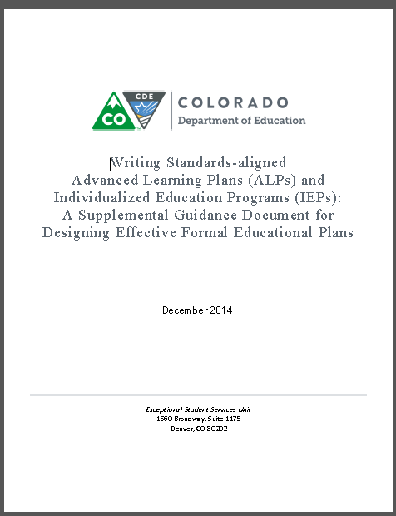
Purpose of the Guidance Document
To set the Colorado Academic Standards as the foundation for instruction and to provide guidance for the state around writing standards-aligned
Advanced Learning Plans (ALPs)
Individualized Education Program (IEP) Teams
Provide resources for districts as they collaborate with families of children and youth with exceptionalities
Notes:
This guidance document has been a collaborative effort of members of the Exceptional Student Services Unit, which includes the Office of Gifted Education and Facility schools along with Colorado educators for students with exceptionalities.

Slide 5
Guiding Questions
There are five questions posted around the room. Please do a gallery walk and stop at the question you would like most to discuss. Jot down some bullet points to summarize the group’s discussion.
How can aligning IEPs to standards support access to the general education curriculum?
How can aligning IEPs to standards focus instruction on more challenging content and skills?
How can aligning IEPs to standards promote a unified system of education for all students?
How can aligning IEPs to standards promote collaboration between general and special educators?
How can aligning IEPs to standards promote making “least dangerous assumptions”?
Kosnitsky, C. (2012) Adapted from presentation to Alabama CASE Spring Outreach Conference.
Notes:
Review at the end. Prep: Need large sticky chart paper/ colored markers with questions at the top of the sheet

Slide 6
Participants’ Desired Outcomes
Notes:
Participants contribute topics/ information they would like to learn more about today.

Slide 7
Starting on the Same Page….
Designing First Best Instruction
Accessible Educational Materials
Standards Survey
Overview Seven Step Process
Terminology
Notes:
We are going to make some starting assumptions that you are using the principles of universal design for learning and providing accessible materials…..On your outline, which Matt will send you electronically, there are links to resources for these that we won’t have time to do this morning.

Slide 8
It’s ALL about Access
Colorado Academic Standards
Learning Preference/Multiple Intelligences
Universal Design for Learning
Differentiated Instruction / MTSS
Adaptations / Accommodations
Special Education & Related Services
Adaptations
Instructional Strategies
Specially Designed Instruction
Assistive Technology
Access to the General Curriculum
Adapted from presentation by C. Kosnitsky (2012) to Alabama CASE Spring Outreach Conference.
Notes:
What skills, knowledge and behaviors must this student acquire to access the general education curriculum?
What growth and progress can be reasonably be expected of this student in the coming year?
Will the expected growth and rate of progress narrow the achievement gap for this student?

Slide 9
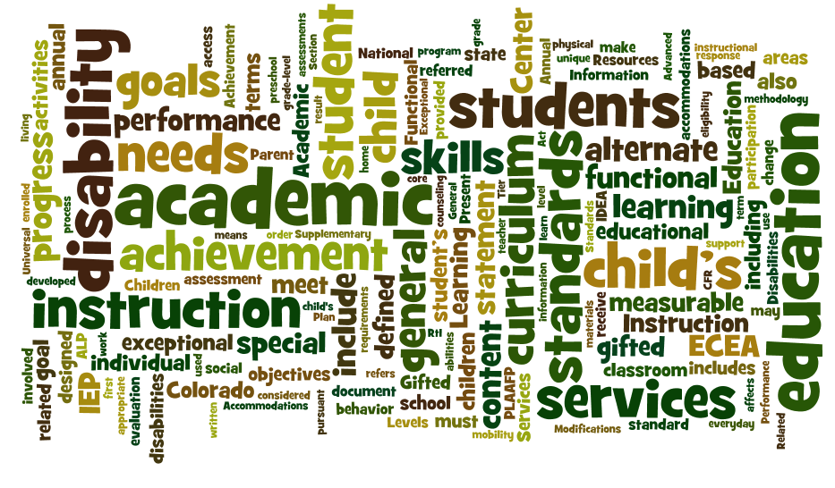
Terminology
Definitions – Writing Standards-aligned IEPs P. 3-7
Notes:
Activity: Each table has an activity set comprised of vocabulary terms and definitions.
Have one person spread out the cards.
As a table, begin matching.
Time: 7 minutes
Reflection: How well did your table do?
What information did you glean from reviewing the terms and definitions?

Slide 10
A Seven-Step Process
Step 1
Review enrolled grade-level standards
Step 2
Gather and analyze data
Step 3
Synthesize Data for Statement of Present Levels of Academic Achievement and Functional Performance
Step 4
Step 5
Step 6
Step 7
Develop measurable annual goals aligned with grade-level academic standards
Monitor and report student progress
Identify specially designed instruction including accommodations and/or modifications needed to access, engage in meaningful participation and make progress in the general education curriculum
Determine how the student will participate in assessment
Project Forum, NASDSE 2007
Handout: Seven Step Booklet
Notes:
This guidance represents a data-driven process model intended to provide information for school staff as they work with families to develop Individualized Education Programs (IEPs) for students who meet eligibility criteria to receive special education services under the federal and state IDEA/ECEA disability categories, including students identified as gifted who also have a disability (Twice Exceptional)

Slide 11
Determine the Academic Achievement Standard
Alternate Standards & Instruction Participation Guidelines Worksheet
Companion Document: Participation Guidelines
Colorado Academic Standards / Extended Evidence Outcomes
Sortable Standards
Standards Side-by-Side Reference Tools
Step 1
Review enrolled grade-level standards
NEW!
Notes:
It is important for IEP Teams to understand the academic content standards for several reasons. First, the standards provide a common language for everyone on the IEP team. This will be essential to increase collaboration and facilitate communication between the student’s family, teachers and related service providers.
When academic content is firmly established through the standards, the IEP team is better able to designate what specialized instruction, individualized supports and related services the student will need to have greater access to and to make progress in that curriculum. The standards also articulate the expected outcomes for students at each grade level. This will help IEP teams identify the gap between the student’s present levels of academic achievement and those grade-level standards in order to focus standards-based IEP goals on the standards that are most essential to that student’s progress.
Naturally, students cannot demonstrate what they know and can do well, if their instruction is not aligned with the state’s adopted instructional standards. The Colorado Academic Standards and the Extended Evidence Outcomes for students who meet participation requirements as a student with a significant cognitive disability, serve as the foundation for the new generation of state assessments. So it stands to reason that consideration of the student’s enrolled grade-level standards is the FIRST step in the process.
And here is where we may perhaps meet some cognitive resistance among some educators. It is commonly said, “Well, James or Sally, can’t possibly do grade-level work---they are not able to read grade-level material.” A statement such as this indicates that often a student’s cognitive functioning is equated with the student’s reading level. We all know there are many factors that may play into the student’s ability to think and reason. However, unless the student’s IEP team has examined a body of evidence to determine that the student will receive instruction on alternate academic achievement standards, then all students are to receive instruction on grade-level content. If they don’t meet the criteria, then they are considered to have cognitive and adaptive functioning that is within normal limits. Therefore, they are able to think about grade-level content; and students with a disability can receive curricular adaptations and accommodations to allow access to and engagement with that grade level content.
We have some tools that will be helpful for teachers….the titles here are linked to the webpages. I’m sure you’re familiar with the CAS/EEO templates and the Sortable Standards, but I am pleased to let you know the new Standards Side-by-Side Reference Tool is now ready and posted.

Slide 12
Standards Pre-Session Survey
Notes:
Rebecca

Slide 13
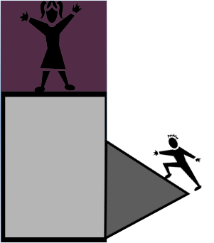
Step 2
Consider multiple sources of data, including a review of current classroom/district/ state assessment data, interviews and observations
R = Review
I = Interview
O = Observations
T = Testing
Gather and analyze data
Knowledge and skills of the enrolled grade level standard
Notes:
In order to make data-driven decisions, the next step of the standards-aligned process is to consider presented factual information about the student’s academic and functional performance in relation to the expectations of the enrolled grade level standard.
In reviewing the standards, a team looks at the skills a student requires for success with the standards. It is about gathering evidence to determine the student’s strengths in relation to the standards and the gap they may have to master the standards.
It is collecting and reviewing data from multiple sources; classroom assessments; diagnostic assessments; state summative assessments; benchmark assessments; district interim assessment and identifying strengths and needs as they relate to the standards.

Slide 14
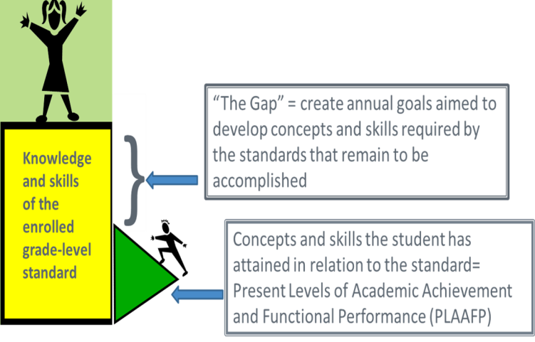
Present Levels of Academic Achievement and
Functional Performance
Step 3
PLAAFP
Data
+
Summary
Notes:
The “present levels” statement is intended to comprehensively describe a child’s abilities, performance, strengths, and needs. It is based on, and arises out of, all the information and data previously collected and known about the child, most especially the full and individual evaluation of the child that must be conducted in accordance with IDEA’s evaluation/eligibility provisions of §§300.301 through 300.311. A well-written present level will describe: the child’s strengths and weaknesses, what helps the child learn, what limits or interferes with the child’s learning, objective data from current evaluations of the child, and how the child’s disability affects his or her ability to be involved and progress in the general curriculum.
Present level statements such as, “Johnny is making progress.” or “Susie is a very out-going child.” are not based upon data. Collecting data to document the student’s performance of skills related to an area of need, can highlight a student’s strengths and clarify how the student’s disability is impacting the child’s ability to perform that skill .
Once the student’s current levels are pinpointed and compared to grade-level standards, a reasonable progression of skills related to the desired target behavior can be identified.
The data provides the professionals with the knowledge of where to begin with the standards and the learning progressions. It focuses on alignment with what all students are expected to know and do. It identifies the skills and knowledge the student has already attained relative to grade-level standards. Thus, the PLAAFP is a synthesis of the data in relation to the standards and is used to decide what standards the student has achieved and what standards remain to be accomplished.
A fully developed, well-written “present levels” is the foundation upon which the rest of the IEP can be developed to specify appropriate goals, services, supports, accommodations, and placement for the child.
http://nichcy.org/schoolage/iep/iepcontents/present-levels#where
Retrieved 9/16/14

Slide 15
Present Levels of Academic Achievement and
Functional Performance
Step 3
PLAAFP
Data
+
Summary
Notes:
The “present levels” statement is intended to comprehensively describe a child’s abilities, performance, strengths, and needs. It is based on, and arises out of, all the information and data previously collected and known about the child, most especially the full and individual evaluation of the child that must be conducted in accordance with IDEA’s evaluation/eligibility provisions of §§300.301 through 300.311. A well-written present level will describe: the child’s strengths and weaknesses, what helps the child learn, what limits or interferes with the child’s learning, objective data from current evaluations of the child, and how the child’s disability affects his or her ability to be involved and progress in the general curriculum. You may hear this referred to as “triangulate the data” or “the golden thread”…..just remember that the data has to fit and the goals have to match.
Present level statements such as, “Johnny is making progress.” or “Susie is a very out-going child.” are not based upon data. Collecting data to document the student’s performance of skills related to an area of need, can highlight a student’s strengths and clarify how the student’s disability is impacting the child’s ability to perform that skill .
Once the student’s current levels are pinpointed and compared to grade-level standards, a reasonable progression of skills related to the desired target behavior can be identified.
The data provides the professionals with the knowledge of where to begin with the standards and the learning progressions. It focuses on alignment with what all students are expected to know and do. It identifies the skills and knowledge the student has already attained relative to grade-level standards. Thus, the PLAAFP is a synthesis of the data in relation to the standards and is used to decide what standards the student has achieved and what standards remain to be accomplished.
A fully developed, well-written “present levels” is the foundation upon which the rest of the IEP can be developed to specify appropriate goals, services, supports, accommodations, and placement for the child.
http://nichcy.org/schoolage/iep/iepcontents/present-levels#where
Retrieved 9/16/14

Slide 16
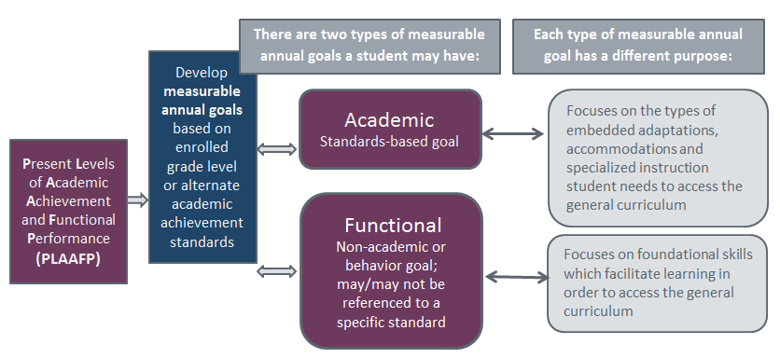

Step 4
Develop measurable annual goals aligned with grade-level academic standards
See the section called Through the Lens… for constructed examples using the A-B-C-D-E method of writing SMART goals.
Notes:
The standards-aligned IEP considers the student’s unique areas of need identified by evaluation data. Academic and/or functional goals, including those related to behavior / executive function. These unique areas of need are then specifically addressed through specialized instruction, related and instructional services, or other supplementary aids and services.
Once the academic achievement standard for instruction has been determined, annual goals can then be developed to close the gap between skills the student currently has to skills required in the grade-level or alternate standard. Standards-aligned IEPs are not intended to define every educational goal for a student, and they are also not meant to eliminate any functional training students require. (Special Educators Look to Tie IEPs to Common Core, Education Week, Published online December 27, 2010; Updated March 23, 2012; Retrieved May 14, 2014).

Slide 17
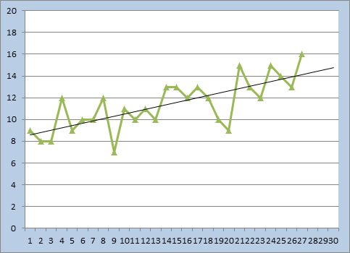
Step 5
Monitor and report student progress
4-Point Decision Making
Notes:
Monitoring a student’s progress assists a teacher or a service provider or a family member in making ongoing instructional decisions about the strategies and interventions being used. It also provides summative evidence that enables the IEP Team to determine whether the student has achieved his or her stated annual goals including the overall growth gained.
Decision making rules have been included in the guidance document.

Slide 18

Specially designed instruction targets the “The Gap”—concepts and skills that remain to be mastered.
Step 6
}
Core Instruction
Specially designed instruction
Accommodations
Modifications
Concepts and skills the student has attained = PLAAFP
Grade-level academic achievement standard = Accommodations = adaptations for Presentation, Response, Timing and Setting
Alternate academic achievement standard = modified materials,
Modified content, along with use of accommodations for access
Handout: IEP/504 Checklist / Table B
Notes:
Accommodations
Accommodations are adaptations made to the instructional and assessment environment that have been made in order for the student with a disability to more fully show what he or she knows and can do. Based upon each child’s unique needs, the use of an accommodation is intended to allow the student to fully access daily instruction and various assessments by reducing the impact of the disability upon the child’s ability to perform academic and functional tasks. Accommodations do not substantially change the performance expectation; however, classroom accommodations and assessment accommodations may be integrated as the information is presented; as the student’s response is given; as the location or conditions of the setting are arranged or how the time is allotted to complete tasks.
Modifications
Students with a significant cognitive disability who meet participation requirements to receive instruction based on alternate academic achievement standards (CAS/Extended Evidence Outcomes EEOs) and participate in alternate assessment (CoAlt Reading/Writing/Communicating, Mathematics, Science and Social Studies) may need accommodations in materials for presentation, response, setting or timing, as well as curricular changes in instructional materials. Accessible materials allow the student to engage with enrolled grade-level topics, but which are modified for content, complexity and rigor. Students who meet participation guidelines to receive instruction on alternate academic achievement standards use accommodations, modified materials and participate in state alternate assessments. Classroom and interim assessments are also to be modified according to alternate standards that align with the student’s instruction. Modifications change the depth of what the student is expected to learn and the academic achievement standard by which the student is evaluated.
Supplementary Aids and Services
Supplementary aids and services can be accommodations and modifications to the curriculum under study or the manner in which that content is presented or a child’s progress is measured. Supplementary aids and services can also include: direct services and support to the child and support and training for the staff who work with that child. National Dissemination Center for Children with Disabilities www.nichcy.org

Slide 19

Specially Designed Instruction
SDI is intended to ACCELERATE instruction to narrow the achievement gap.

Slide 20
What is Specially Designed Instruction?
By definition, special education is “specially designed instruction” (§300.39). And IDEA defines that term as follows:
(3) Specially designed instruction means adapting, as appropriate to the needs of an eligible child under this part, the content, methodology, or delivery of instruction—(i) To address the unique needs of the child that result from the child’s disability; and(ii) To ensure access of the child to the general curriculum, so that the child can meet the educational standards within the jurisdiction of the public agency that apply to all children. [§300.39(b)(3)]

Slide 21


Requires Collaboration!
Access to the General Curriculum
Co-Planning
Adaptation of Materials / Assessments
Format
Type of Media
Text Complexity / Lexile levels
Assistive Technology
Specially Designed Instruction
Intensive focus on the “gaps” identified between the student’s present levels and skills required by standards
Resources: District Sample Curriculum Units and the Colorado Instructional Accommodations Manual
Notes:
Joy Zabala from CAST describes SDI as instruction the student NEEDS in order to be successful, but that is not provided elsewhere or at any other time in this student’s grade level. SDI is intended to ACCELERATE instruction to narrow the achievement gap.

Slide 22
Student Characteristics
Accommodation
Modifications
Assessment
Step 7
Determine how the student will participate in
Assessment
Assessment is built upon
academic achievement standard.

Slide 23
Keep the Process in Mind….
Academic Optimism
Bridges
Barriers
GAPS

Slide 24
Academic Optimism Do you believe….
Three foundations of Academic Optimism:
belief that all students can be successful and belief in yourself and your abilities as a teacher
Academic Emphasis
Collective Efficacy
Relational Trust
Notes:
*Article: The Least Dangerous Assumption – Jorgensen
High expectations, achievable goals, student respect for academics
“Efficacy” means an ability to produce a desired result
Teachers believe and create a culture of academic optimism, positive efficacy collectively amongst staff leads to change
All stakeholders cooperate to improve learning, trust leads to cooperative learning and supports risk taking

Slide 25
Closing the Attitude Gap
Principal Baruti Kafele
foundationforadvancedlearning@gmail.com Fulfordfoundation
Notes:
Framework for Closing the Attitude Gap:
Environment for Learning
Attitude toward Students
Relationship with Students
Compassion for Students
Relevance in Instruction

Slide 26

Identifying the Tenets of Academic Optimism
In your opinion, what is the current culture of your school around Academic Expectations for students with a disability?
Are you witnessing gains in student achievement using your current methodologies?
Do you feel confident in your own ability and your school’s ability to address the learning needs of all students?
Next Steps to accomplish change?
Brainstorming Activity

Slide 27

The alignment between the student’s readiness or present level of performance and the curriculum and setting expectations
Examples:
-Student understands the
main idea and
-understands academic
vocabulary
The Bridge
The General Education Curriculum
Notes:
Instances in which the instruction situation requires things of the student that he or she can do without some level of change to the environment or curriculum. Based on their strengths, preferences, and interests.
Requires thorough evaluation and assessment data in the PLAAFP to identify bridges. These are the items that the student has that will help them reach academic or behavioral success.

Slide 28

The Barrier(s)
The thing(s) that exist in the curriculum, instruction or environment that prevent access to learning and the things the student can’t do as a result of a disability
Physical
Sensory
Emotional
Notes:
Examples:
-Student reads text below grade
level,
- Numeracy skills significantly below grade level
- Has difficulty with abstract concepts and vocabulary
Need another word for things. Use accommodations and adaptations to access the general curriculum.
Need to identify ways to access the curriculum, relate to the accommodations, modifications and assistive technology. These are areas that aren’t readily changed through direct specialized instruction. Barriers tend to be things that exist and will not change for the student and need focused effort to support the student’s efforts toward accommodating and learning the skills needed for self-advocacy and/or digital technology.

Slide 29
Embedded Supports
The Barrier(s)
Response
Timing
The embedded supports that exist to adapt the curriculum, instruction or environment and provide access to learning
Resource: Colorado Instructional Accommodations Manual
Setting
Presentation
Notes:
Examples:
-Student reads text below grade
level,
- Numeracy skills significantly below grade level
- Has difficulty with abstract concepts and vocabulary
Need another word for things. Use accommodations and adaptations to access the general curriculum.
Need to identify ways to access the curriculum, relate to the accommodations, modifications and assistive technology. These are areas that aren’t readily changed through direct specialized instruction. Barriers tend to be things that exist and will not change for the student and need focused effort to support the student’s efforts toward accommodating and learning the skills needed for self-advocacy and/or digital technology.

Slide 30
The Gap
Specially Designed Instruction
Missing Critical Skills
The discrepancy between the student’s readiness or present level of performance and the curriculum and setting expectations, things the student cannot do without some level of change to the curriculum or setting demands
Notes:
Missing critical skills or knowledge that are necessary to achieve standards. These are skills or knowledge that are not taught, no longer taught at the student’s enrolled grade level or require a higher level of intensity of teaching.
To address these areas the student will need specialized instruction, accommodations or possibly modifications. These are the areas to focus on when the goals are written. They require either direct instruction and focus or support for the student.

Slide 31

How do Standards apply to students with a Disability?
PARCC Statement
Dr. Margaret McLaughlin is Professor in the Department of Special Education and Associate Director of the Institute for the Study of Exceptional Children and Youth at the University of Maryland.
“The bottom line is ready means never. If you wait to get these
kids mastering basic skills, then there will never be time to learn
and master the critical skills and knowledge they need to progress in their grade-level curriculum. The key question is, ‘How do we take a child who has missing skills,
and provide goals and instruction in grade-level
content?’”
Notes:
This is the challenge that the IEP Team addresses when designing an Individual Education Program. The Seven Step Process is designed to help the Team consider all aspects of the student’s academic and functional needs.

Slide 32
Modeling the Process…
Melita
Notes:
Handout: Melita’s PLAAFP to follow along

Slide 33
A Seven-Step Process
Step 1
Review enrolled grade-level standards
Step 2
Gather and analyze data
Step 3
Synthesize Data for Statement of Present Levels of Academic Achievement and Functional Performance
Step 4
Step 5
Step 6
Step 7
Develop measurable annual goals aligned with grade-level academic standards
Monitor and report student progress
Identify specially designed instruction including accommodations and/or modifications needed to access, engage in meaningful participation and make progress in the general education curriculum
Determine how the student will participate in assessment
Project Forum, NASDSE 2007
Handout: Seven Step Booklet
Notes:
Steps for Goal Prioritization: Question 1: What are the prerequisite skills that this student needs to master in order to meet the standards and benchmarks determined to be a priority for this student at this time? It might be helpful for the IEP team to focus on the benchmarks associated with the priority standards, as they represent the specific knowledge or skills that students should acquire by the end of that grade level. For example, the student may need to learn whole numbers and operations before working with fractions and decimals, or in reading, the student may need to learn prefixes, suffixes and word endings before they can decode multi-syllable words.
Question 2: Are there accommodations and/or assistive technologies that would help the student meet the standards? Think about the accommodations and/or assistive technologies that have already been effective for this student. Can these same accommodations or assistive technologies be used to help the student meet the standards? For example, can the student determine the main idea of informational text and explain how main idea is supported by key details by using text-to-voice software or audio books, while still working on foundational reading skills such as phonics and word recognition or reading fluency?
Question 3: Are there non-academic barriers that should be addressed to help this student meet the standard(s)? Remember in step 3 of the PLAAFP, you considered areas such as the student’s communication skills and social-emotional, and behavioral concerns; his or her mental and physical health; and attendance and tardiness records. Are any of these factors affecting the student’s ability to meet the targeted standards? If so, how should these non-academic barriers be addressed in the IEP?
Question 4: How much growth should this student be expected to make toward meeting this standards within the year of the IEP?
When the IEP team determines that a student is eligible to take the MCA-Modified assessment and subsequently have IEP goals based on grade-level academic content standards, one of the determining factors in making that decision is that the IEP team believes that it is highly unlikely that the student will achieve proficiency on the grade-level content standards within the year the test is administered, even with specially designed instruction. Therefore, it follows that the IEP goal should not be a simple reiteration of the grade-level standard or benchmark. The IEP team will need to estimate how much progress is reasonable to expect the student to make within the year of the IEP. The process of estimating growth will become easier over time and will be facilitated if student progress monitoring data is routinely collected on the standards-based goals and objectives.
Based on the answers to questions 1-4, what standards-based IEP goals should be established for this student?
It is the process used in getting to the standards-based IEP goals that is most important. Are the right people at the table, including the student’s grade-level general education teachers with expertise in reading, mathematics or both? Are the data presented in the PLAAFP current and from multiple sources, and can these data be easily aligned to the grade-level academic content standards so that a gap is identified? Are the standards prioritized in such a way that IEP goals based on those standards are likely to have the greatest impact on the student’s progress in closing the gap? It is not required that a standards-based IEP goal document the specific standard number or benchmark on which it is based, but doing so may make the connection between the goal and the specific standard or benchmark more explicit to all members of the IEP team, including parents and administrators, in addition to making it easier for program monitors to understand the logic of the IEP team’s decision making. Standards-based goals will be at least some of the goals on the IEP. Remember, the IEP Team must also consider non-academic goals and objectives to address other educational needs that result from the student’s disability.
The final question in this process is: How will the student’s progress toward meeting their IEP goals be monitored? The 2007 ESEA regulations not only require that the IEP of a student assessed by the MCA-Modified include IEP goals that are based on the academic content standards for the grade in which the student is enrolled, the regulations also require that these goals be designed in a way that the student's progress can be monitored in achieving the goals.

Slide 34
Writing Measurable Standards-based Annual Goals

Slide 35
A-B-C-D-E
Method of Writing SMART Measurable Annual Goals Aligned to CAS/EEOs
Reference Barbara Bateman’s book, From Gobbledygook to Clearly Written Annual IEP Goals
Exceptional Student Services Unit 2015
Linda Lamirande Rebecca Odegard-Siegele
Notes:
This method has “evolved”—I have taken portions mainly from Barbara Bateman’s book, From Gobbledygook to Clearly Written Annual IEP Goals and added a piece we learned from Mary Schillinger and Becky Wetzel. It is not a “required” method; but is simply intended to be an easy-to-remember method of including all the needed elements for a measurable annual goal.

Slide 36
For compliance with IDEA…
The IEP must show a direct relationship between the student’s present levels of academic achievement and functional performance, the goals, and services that are to be provided to meet these goals.
Simi Valley Unified Sch. Dist., 44 IDLER 106 (SEA CA 2005)
…a measurable goal must have a corresponding measured present level of performance in the IEP
From Gobbledygook to Clearly Written Annual IEP Goals by Barbara D. Bateman IEP Resources 2007 p. 10
Notes:
Regardless of the method you use, it is the elements that reviewers look for in a compliance review….
Barbara Bateman, a teacher and lawyer, writes from her experiences as a program evaluator and expert witness in special education cases. Her book is titled……

Slide 37
Are benchmarks or short-term objectives required?
“It depends…. Whereas the 1997 reauthorization of IDEA required that all annual goals include benchmarks or short-term objectives, IDEA now requires these provisions only for students who take alternate assessments aligned to alternate achievement standards.”
The IEP from A to Z by Diane Twachtman-Cullen and Jennifer Twachtman-Bassett
Notes:
For students who do not qualify for alternate standards, the IEP goal should relate to the need identified in the PLAAFP and be based on grade level standards with/without accommodations. The IEP Team may choose to include benchmarks or short-term objectives as part of the annual goals in order to assist in monitoring the student’s progress.
However, for those students who take alternate assessments aligned with alternate achievement standards, the IEP must contain a description of at least two benchmarks/short-term objectives as part of the student’s annual academic goals.

Slide 38
SMART Goals…
Strategic and Specific (not vendor/program specific)
Measurable (has all the elements)
Attainable (use Action words--you should be able to literally see what’s happening)
Results Driven (Realistic and Relevant)
Time Bound
Notes:
In practice you have been writing SMART goals and objectives. There are any number of methods to produce SMART goals….5-Point Goals, and others…But I came across a book that I thought offered an easy way to remember all the essential elements of a measurable goal, so I want to share that with you and give you yet another way to look at these SMART goals, but first lets look at the required elements.
Reference Barbara Bateman’s book, From Gobbledygook to Clearly Written Annual IEP Goals

Slide 39

Please meet Melita….
Melita has strengths in the areas of letter-word identification, conversational language, demonstrates a strong desire to achieve, has mastered text structure of cause/effect, gathers relevant information for research, can peer edit, uses assistive technology for reading/writing, and when provided multiple means of input in addition to print, she is better able to gather information, make connections, and develop and deliver oral presentations. She collaborates with peers and contributes to class discussions.
Notes:
Meet Melita, an eighth grader. This information is a summary of the data contained in Melita’s PLAAFP.
Melita has strengths in the areas of letter-word identification, conversational language, demonstrates a strong desire to achieve, has mastered text structure of cause/effect, gathers relevant information for research, can peer edit, uses assistive technology for reading/writing, and when provided multiple means of input in addition to print, she is better able to gather information, make connections, and develop and deliver oral presentations. She collaborates with peers and contributes to class discussions.
Melita’s teacher, Ms. Happy, interviewed Melita on 9/3/14, concerning her post secondary aspirations for education/training, career, and independent living. Melita would like to own and operate her own Greek restaurant. Her grandmother has taught her how to cook Greek food. Melita has designed her logo for her restaurant and has been reading various menus from local Greek restaurants.
Melita’s difficulty with applying close reading strategies, such as making inferences, complex predictions, and utilizing text structures affects her progress in comprehending 8th grade literacy materials. She is hesitant to engage in a wide range of nonfiction and real-life reading at her independent level. Due to her working memory weakness, Melita requires a systematic approach to comprehension instruction including the teaching of visualization and explicit reading comprehension strategies.
The IEP team will base Melita’s goals on the enrolled grade-level academic achievement standards and will address her needs that are stated in the PLAAFP. Furthermore, her goals will describe skill attainment and project her performance at the end of the twelve month IEP period.

Slide 40
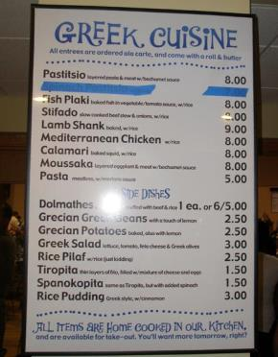

Transition Stem
In order for Melita to own and operate her own café, “Melita's”,
Photo retrieved http://www.clevelandpeople.com/images/greek/greekfest-2008/greek-food-menu.jpg
Notes:
Melita is in eighth grade. Students who are 15 years old (or earlier if appropriate) or by the end of 9th grade, must have the transition requirements in their IEPs. For Melita, the IEP team made the decision to include the transition information in her annual review. This is the transition stem that will be added to her measurable goal.

Slide 41
Melita’s Goal
In order to comprehend text for a culinary arts degree, when given printed/audio text, Melita will use the steps of a visual imagery strategy (searching for picture words, creating or changing a scene, entering details, naming parts, and evaluating the visual picture) with 80% accuracy for use of the steps and 80% accuracy for comprehension of text through the maintenance phase as evaluated by a teacher-created checklist and a set of 5 comprehension questions.

Slide 42

Audience
A
$=$
Student / Learner
Melita
Identifies WHO?
Data Without Tears by Terri Chiara Johnston

Slide 43

Behavior
b
$$=$$
Identifies WHAT you want the audience to do
Includes the specific actions that the student is to perform, demonstrate, or exhibit:
“use the steps of a visual imagery strategy (searching for picture words, creating or changing a scene, entering lots of details, naming the parts, and evaluating the visual picture) ”
+ INCREASE
DECREASE
The number of times the behavior occurs
Data Without Tears by Terri Chiara Johnston
Notes:
The target behavior should be so clear that a person who does not know the student is able to determine whether the student is demonstrating the behavior. (p. 13)
….it also describes exactly how you expect him to do it. (p. 14)

Slide 44

Condition
C
$$=$$
Refers to the context in which you expect the student to perform the new skill or reduce the occurrence of the problem behavior. Include any special materials the student may need or supports.
Melita’s condition: when given printed or audio text
Data Without Tears by Terri Chiara Johnston
Notes:
This is sometimes thought of as the adult action part of the statement since it includes the context in which you expect the student to perform the new skill or reduce the occurrence of the problem behavior. To include any special materials or supports, you may begin with “Given….When provided with…..a selected set of matching vocabulary sight word cards…….” Again, use generic terms…..instead of Dolch Sight Words…. Or raised line ½” handwriting paper—not Handwriting Without Tears…..

Slide 45
Condition statements
Using an augmentative communication device during circle time with one verbal prompt,
Given the manual sign for TOILET and a partial physical prompt,
During a 15 minute recess on the playground,
When provided a four-function calculator,
During transition from one activity to another and with one gestural prompt toward the child’s posted schedule,
Data Without Tears by Terri Chiara Johnston
Notes:
Examples

Slide 46
Degree
D
$$=$$
includes
Criteria /Timeframe and Frequency
States clearly what is considered to be acceptable performance
Includes the measure and the metric
Melita’s Degree: with 80% accuracy for use of the steps and 80% accuracy for comprehension of text through the maintenance phase
Data Without Tears by Terri Chiara Johnston
Notes:
The Degree tells….to what extent….or what is considered to be acceptable performance. Degree may include criteria---4/5 opportunities, 80%, -- and frequency , how often does the student demonstrate the skill---what you can count….and also timeframe comes under Degree

Slide 47
Degree/Criteria Statements
Four out of five opportunities over a two-week period
Number correct
Fifteen out of 20 correct responses
Within a five-minute time period
Label all 10 items correctly
With 85% accuracy across all observation periods
On five consecutive trials
Completes all steps
Over two consecutive weeks
By the end of the first grading period
By a certain date
Data Without Tears by Terri Chiara Johnston
Notes:
examples

Slide 48

Evaluate
E
$$=$$
(acceptable performance)
as measured by…….
a district writing rubric
a (generic reference—not specific vendor product name)
Melita’s Evaluation: as evaluated by a teacher-created checklist and a set of 5 comprehension questions
M. Schillinger / B. Wetzel Sept. 25th Presentation-Denver
Notes:
The Degree tells….to what extent….or what is considered to be acceptable performance. Degree may include criteria---4/5 opportunities, 80%, -- and frequency , how often does the student demonstrate the skill---what you can count….and also timeframe comes under Degree

Slide 49
Melita’s Goal
In order to comprehend text for a culinary arts degree, when given printed/audio text, Melita will use the steps of a visual imagery strategy (searching for picture words, creating or changing a scene, entering details, naming parts, and evaluating the visual picture) with 80% accuracy for use of the steps and 80% accuracy for comprehension of text through the maintenance phase as evaluated by a teacher-created checklist and a set of 5 comprehension questions.

Slide 50
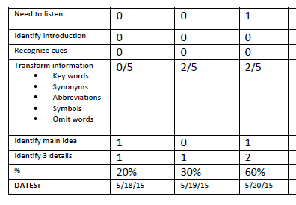
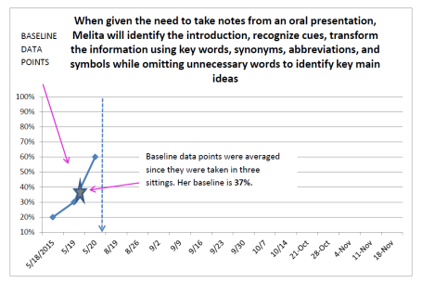
Melita’s Progress Monitoring
When given the need to take notes from an oral presentation, Melita will identify the introduction, recognize cues, transform the information using key words, synonyms, abbreviations, and symbols while omitting unnecessary words to identify key main ideas and details with 80% on 4 of 5 opportunities over 4 weeks.
Baseline is the average of the first 3 data points.
Notes:
Here is one of Melita’s Goals: When given the need to take notes from an oral presentation, Melita will identify the introduction, recognize cues, transform the information using key words, synonyms, abbreviations, and symbols while omitting unnecessary words to identify key main ideas and details with 80% on 4 of 5 opportunities over 4 weeks.
Baseline refers to the beginning measurement of a behavior i.e., number of outbursts, answer inference questions, match vocabulary. A baseline of behavior was obtained for Melita for each IEP goal before instruction began. For this goal, her case manager created a PROBE for note taking from oral presentations which consisted of a checklist for scoring when Melita took notes from oral presentations, to measure her progress. The teacher obtained baseline over three different days and thus, the average of the three data points, or 37%, was plotted on the graph.
The baseline measurement, compared to later data points, gives the IEP team a starting point to measure how effective the specially designed instruction is for this goal. The three data points for baseline are separated and labeled on the graph with a line to indicate the data points were collected prior to instruction.

Slide 51
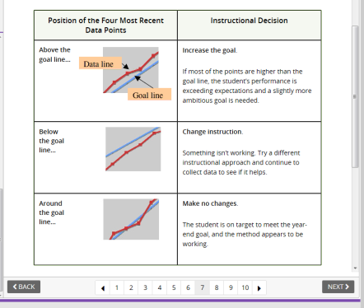
Decision-making Rules
The IRIS Center for Training Enhancements. (2005). Classroom assessment (part 2): Evaluating reading progress. Retrieved on August 20, 2015 from http://iris.peabody.vanderbilt.edu/module/rpm/

Slide 52
Progress Monitoring and Decisions

Slide 53
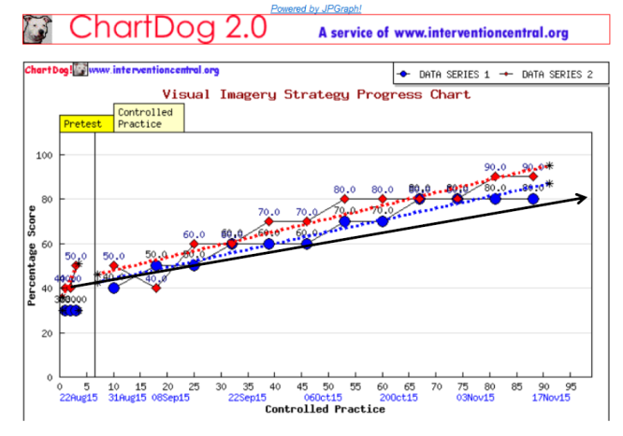
Progress Monitoring for Melita
In order to comprehend text for a culinary arts degree, when given printed or oral text, Melita will use the steps of a visual imagery strategy (searching for picture words, creating or changing a scene, entering details, naming the parts, and evaluating the visual picture) with 80% accuracy for use of the steps and 80% accuracy for comprehension of text through the maintenance phase.

Slide 54
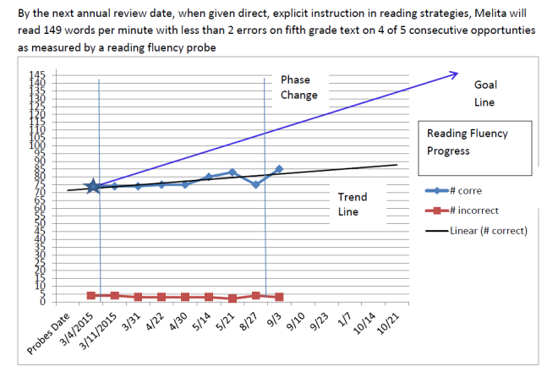
Progress Monitoring Decisions

Slide 55
Your Turn to Dig….Application Practice and Discussion
Locate Resources
Worksheet
Choose a PLAAFP
Follow the Process
Share your Learnings
Your Own IEP
Reflection Rubric
Notes:
Present Reflection Rubric to consider current IEP examples

Slide 56
A Seven-Step Process
Step 1
Review enrolled grade-level standards
Step 2
Gather and analyze data
Step 3
Synthesize Data for Statement of Present Levels of Academic Achievement and Functional Performance
Step 4
Step 5
Step 6
Step 7
Develop measurable annual goals aligned with grade-level academic standards
Monitor and report student progress
Identify specially designed instruction including accommodations and/or modifications needed to access, engage in meaningful participation and make progress in the general education curriculum
Determine how the student will participate in assessment
Project Forum, NASDSE 2007
Handout: Seven Step Booklet
Notes:
This guidance represents a data-driven process model intended to provide information for school staff as they work with families to develop Individualized Education Programs (IEPs) for students who meet eligibility criteria to receive special education services under the federal and state IDEA/ECEA disability categories, including students identified as gifted who also have a disability (Twice Exceptional)

Slide 57
Reflection
How can aligning IEPs to standards support access to the general education curriculum?
How can aligning IEPs to standards focus instruction on more challenging content and skills?
How can aligning IEPs to standards promote a unified system of education for all students?
How can aligning IEPs to standards promote collaboration between general and special educators?
How can aligning IEPs to standards promote making “least dangerous assumptions”?
Kosnitsky, C. (2012) Adapted from presentation to Alabama CASE Spring Outreach Conference.
Notes:
REVIEW bullets on sticky chart paper/ colored markers with questions at the top of the sheet

Slide 58
Take Away…..
Make a Layered Look Book Foldable® for Addressing Instructional Shifts in English Language Arts and Mathematics

Slide 59
Text Complexity
How challenging is the material for the child at their specific grade level?
What makes a book “hard” to read?
Learning A-Z The Lexile Framework for Reading

Slide 60
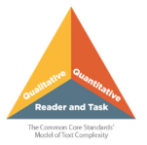
Text Complexity
Qualitative dimensions
levels of meaning
structure
language conventionality and clarity
knowledge demands
Lexile codes provide more information about a book's characteristics, such as its developmental appropriateness, reading difficulty, and common or intended usage.
Quantitative measures
word frequency and sentence length
typically measured by computer software
The Lexile® Analyzer measures text demand based on these two widely adopted variables.
Reader and task considerations
students' knowledge, motivation and interests.
The free "Find a Book" search helps readers build custom book lists based on their ability (Lexile measure) and personal interests or school assignments.

Slide 61
Text Complexity
Text Complexity in the Dynamic Learning Maps Alternate Assesssment white paper – Dr. Karen Erickson
Text Complexity: Qualitative Measures Rubric – Informational Text
Text Complexity: Qualitative Measures Rubric – Literary Text
Article: 7 Actions Teachers Can Take Right Now: Text Complexity
http://textproject.org/assets/text-matters/Text-Matters_7-Actions-Text-Complexity.pdf

Slide 62
Adapting Text

Slide 63
Authentic Text
Authentic, that is, materials produced primarily for the use of native speakers of the target language, are easily available from a number of sources for most of the world. Some more common sources include:
*ESL Base
• Books • Magazines • Newspapers • TV • Radio • Internet • Videos • Audiocassettes • Course books • CDs • Libraries

Slide 64

Adapting Text
Adjusting Lexile Level
NEWSELA https://www.newsela.com/articles/goodall-book/id/10476/
The Lexile Framework for Reading (Handout)
Type or copy and paste the text that needs to be rewritten into Word
Lexile Analyzer
PARCC
Appendix B: Text Exemplars and
Sample Performance Tasks
Text Compactor
DLM Exemplar Text Supports

Slide 65
Adapting Text Demo
Open Appendix B: Text Exemplars and Sample Performance Tasks http://www.corestandards.org/assets/Appendix_B.pdf
Save As: to your hard drive (PDF)
Open to Page 64
Babbitt, Natalie, Tuck Everlasting
Notes:
Exit PPT and demo steps
Handout and annotation symbols

Slide 66
Adapting Text Demo
Hold mouse down to highlight text
Cut and Paste into Word
Adjust print size and margins to leave room for close reading annotation
Highlight vocabulary

Slide 67
Babbitt, Natalie. Tuck Everlasting. New York: Farrar, Straus and Giroux, 1975. (1975)
From Chapter 12
The sky was a ragged blaze of red and pink and orange, and its double trembled on the surface of the pond like color spilled from a paintbox. The sun was dropping fast now, a soft red sliding egg yolk, and already to the east there was a darkening to purple. Winnie, newly brave with her thoughts of being rescued, climbed boldly into the rowboat. The hard heels of her buttoned boots made a hollow banging sound against its wet boards, loud in the warm and breathless quiet. Across the pond a bullfrog spoke a deep note of warning. Tuck climbed in, too, pushing off, and, settling the oars into their locks, dipped them into the silty bottom in one strong pull. The rowboat slipped from the bank then, silently, and glided out, tall water grasses whispering away from its sides, releasing it. Here and there the still surface of the water dimpled, and bright rings spread noiselessly and vanished. “Feeding time,” said Tuck softly….

Slide 68
Adapting Text Demo
Copy original text
Open Text Compactor http://textcompactor.com/
Paste text

Slide 69
Adapting Text Demo
For Read Aloud – PDF
View > Read Out Loud > activate or deactivate/ read selection/whole page
View > Full Screen Mode (Can Zoom – Control + Roll Mouse or + at top)
Natural Readers software http://www.naturalreaders.com/
Many others…..

Slide 70
Adapting Text Complexity Demo
Rewordify https://rewordify.com/index.php
Copy and paste the Tuck Everlasting text into the top box.

Slide 71
Some Close Reading Strategies

Slide 72
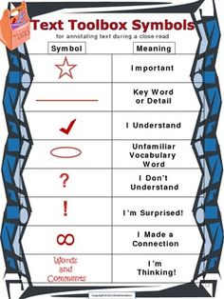
Strategies for Close Reading
A Close Look at Close Reading
http://nieonline.com/tbtimes/downloads/CCSS_reading.pdf
Videos on Text Annotation
How to Do Close Reading of Text
https://www.youtube.com/watch?v=jrly3EtnT8I
Focus on Close Reading
https://www.youtube.com/watch?v=2anzoCrsgfw
Close Reading Strategies with Informational Text
https://www.youtube.com/watch?v=9emLkXlMcOs
Screencast – Annotating a Text
https://www.youtube.com/watch?v=pf9CTJj9dCM

Slide 73
DLM Text Exemplar Support
Tarheel Reader
www.tarheelreader.org
DLM Exemplar Text Support
http://secure.dynamiclearningmaps.org/unc/texts/

Slide 74
References
The IRIS Center for Training Enhancements. (2005). Classroom assessment (part 2): Evaluating reading progress. Retrieved on August 20, 2015 from http://iris.peabody.vanderbilt.edu/module/rpm/

Slide 75
CDE Contacts
Linda Lamirande
Accommodations & Assessment Specialist
Lamirande_l@cde.state.co.us 303-866-6863
Rebecca Odegard-Siegele
Accountability Specialist
odegard-siegele_r@cde.state.co.us 303-866-5923
Njal Schold
Accountability Specialist
schold_n@cde.state.co.us 303-866-6649

